Slide 1

ANALYSIS OF Worldwide Tech Job Salaries

Slide 2


Slide 3


INTRODUCTION
The dataset contains salary information for tech professionals across the globe for the year 2025-2020. It includes key details such as job titles, experience levels, salary , employment types, remote work ratios, and company characteristics like size and location.
The data enables analysis of compensation trends across different roles, experience levels, geographic regions, and work arrangements. It is especially useful for understanding the impact of remote work and company size on employee salaries.

Slide 4

Objectives
To determine the average salary based on experience.
To analyse salary trends across various tech job roles globally.
To assess the effect of remote work on salary levels.
To Identify high-paying job roles in the tech industry across different regions.

Slide 5

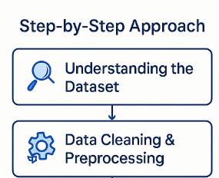
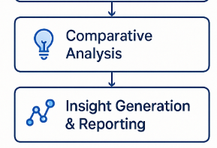
METHODOLOGY
Tools & Technologies Used
Python (Jupyter Notebook)
SQL (MySQL Workbench)
POWER BI

Slide 6

IMPLEMENTATION

Slide 7

PROBLEM STATEMENT ---- 01

Slide 8

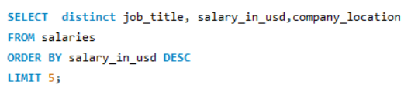
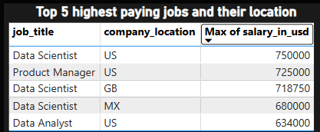
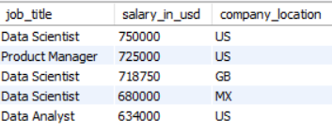
Identify the highest-paying tech job roles globally
US = United States, CA = Canada, GB = United Kingdom (Great Britain), NL = Netherlands, MX= Mexico

Slide 9
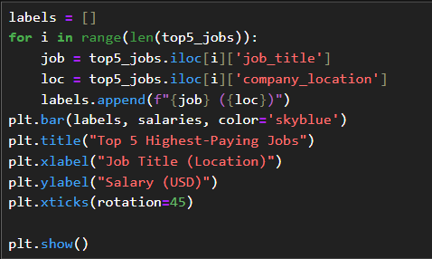
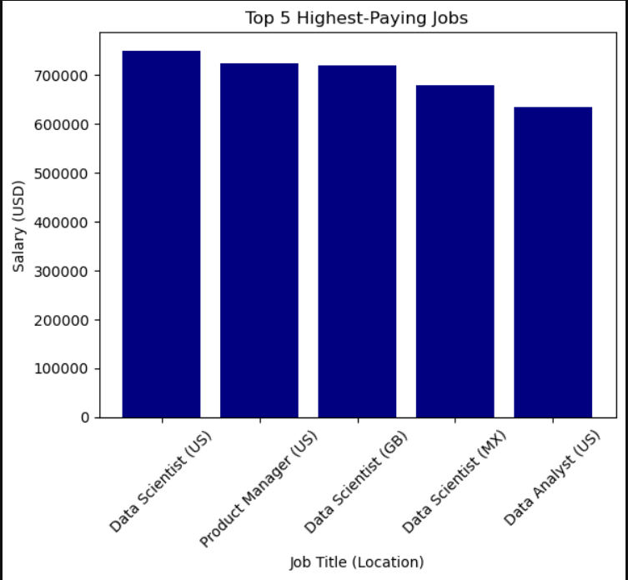
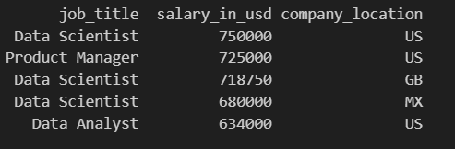
PYTHON CODE

Slide 10
PROBLEM STATEMENT ---- 02

Slide 11
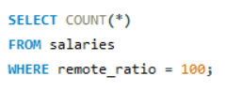
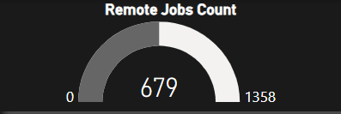

Quantify how many jobs are fully remote
This helps to evaluate the extent to which companies have adopted 100% remote work models and the demand for location-independent roles. It Counts the total number of jobs in the dataset that are fully remote (100%)

Slide 12
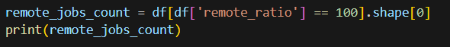

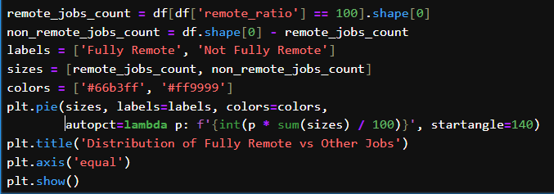
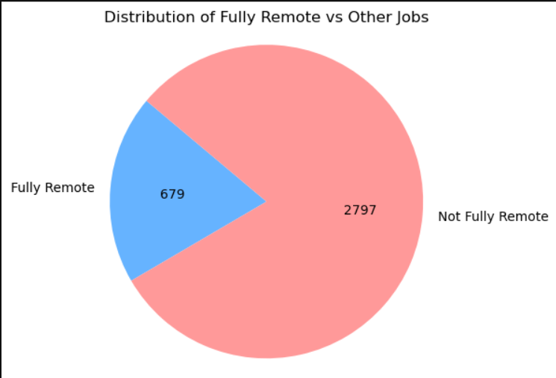

PYTHON CODE

Slide 13
PROBLEM STATEMENT ---- 03

Slide 14
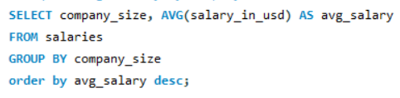
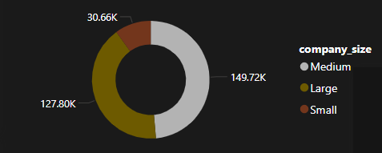
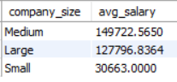
Examine how average salaries vary across different company sizes
Company size is often a key factor influencing compensation in the tech industry. Larger organizations may offer higher salaries due to greater resources, while smaller firms might offer less but with other benefits..

Slide 15
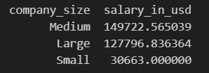
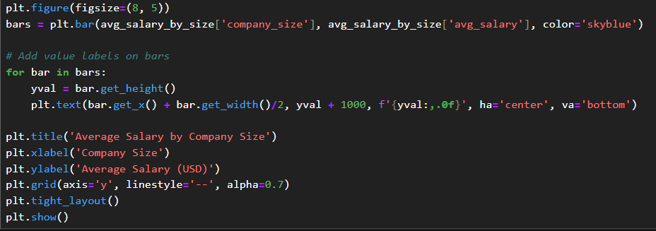
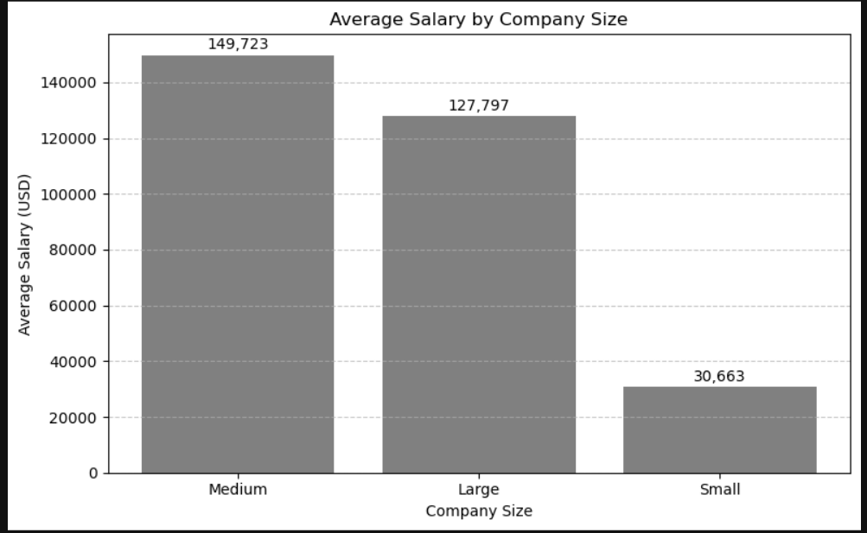
PYTHON CODE

Slide 16
PROBLEM STATEMENT ---- 04

Slide 17
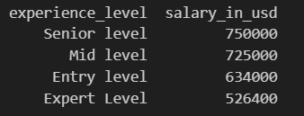
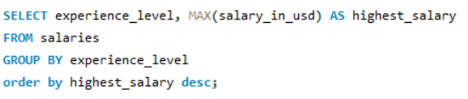
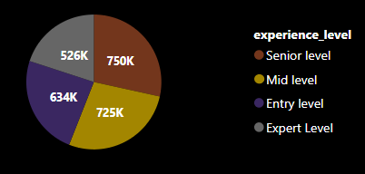
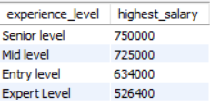
Find the maximum salaries offered at each experience level

Slide 18
PROBLEM STATEMENT ---- 05

Slide 19

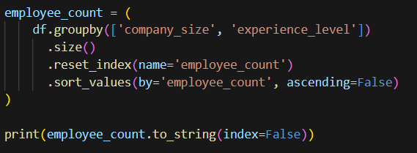
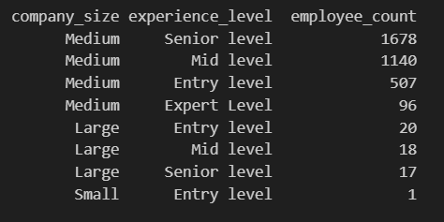
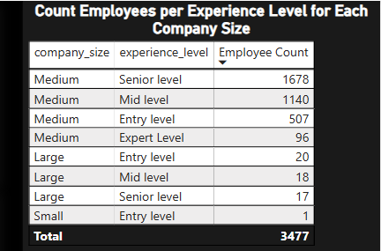
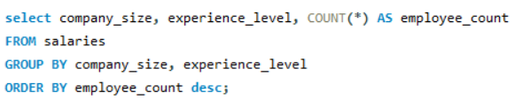
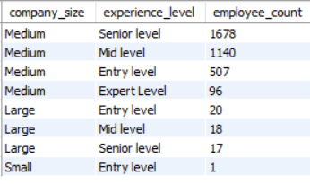
Which company size employs the most people at specific experience levels

Slide 20
PROBLEM STATEMENT ---- 06

Slide 21
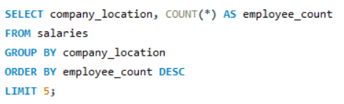
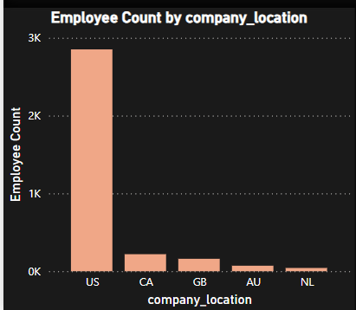
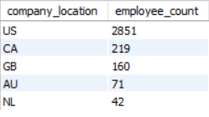
Which countries are leading in tech employment?
The query calculates the salary gap (difference between highest and lowest salary) for each experience level and lists these gaps in descending order of experience level.
Here, US = United States, CA = Canada, GB = United Kingdom (Great Britain), NL = Netherlands

Slide 22

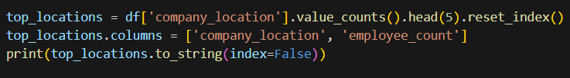
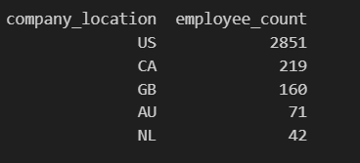
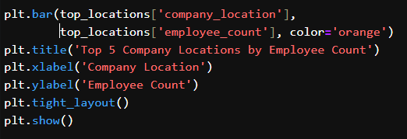
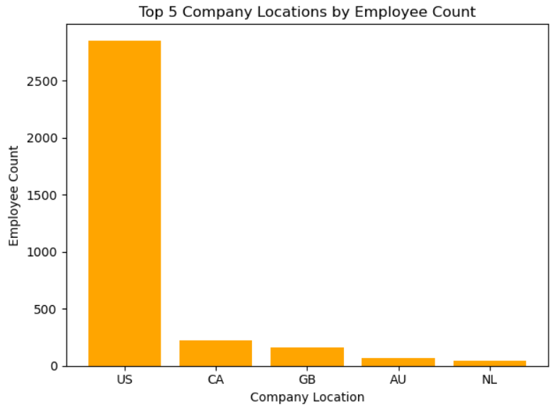
PYTHON CODE

Slide 23
PROBLEM STATEMENT ---- 07

Slide 24

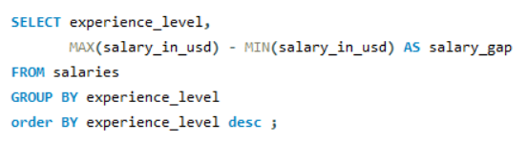
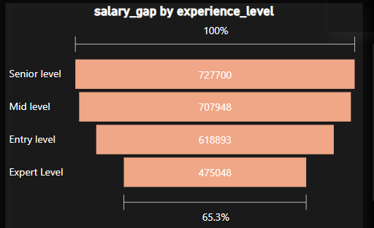
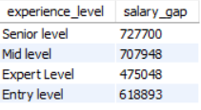
Which experience level has the widest salary gap?

Slide 25

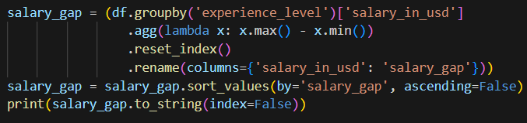
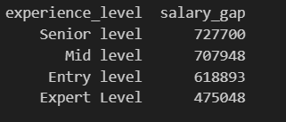
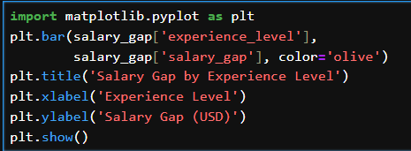
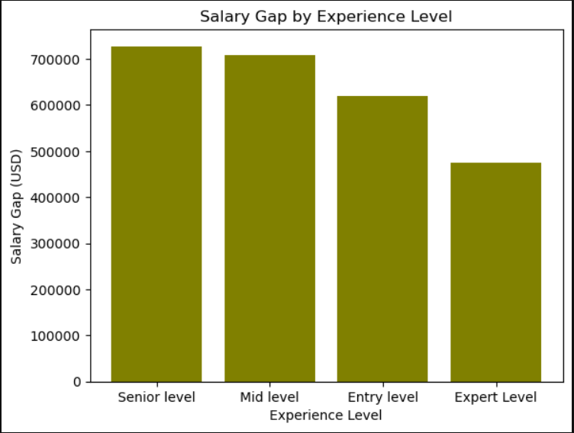
PYTHON CODE

Slide 26
PROBLEM STATEMENT ---- 08

Slide 27
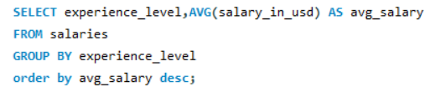
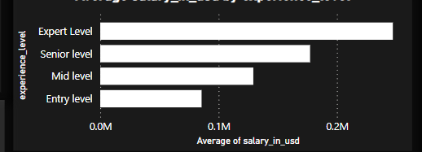
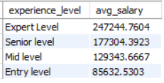
Analyze how average salaries differ across experience levels in the global tech industry

Slide 28

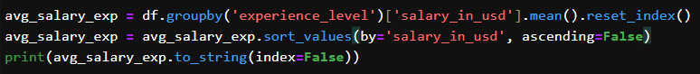
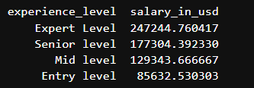
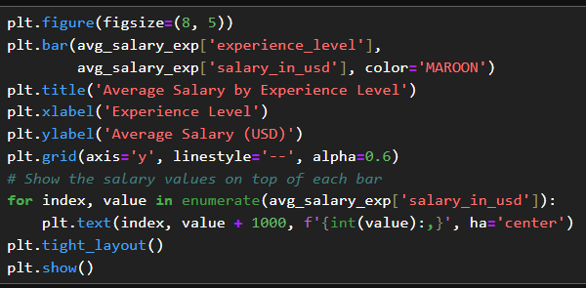
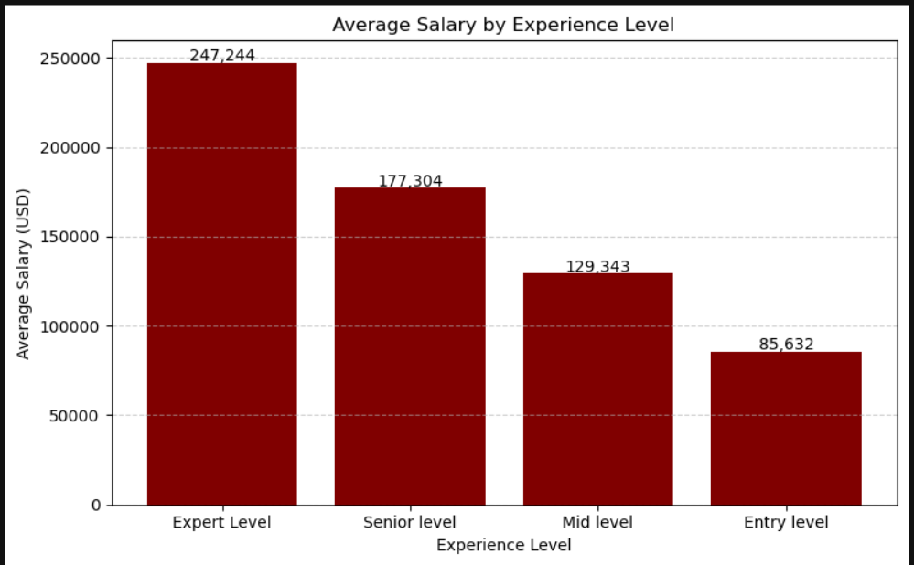
PYTHON CODE

Slide 29
PROBLEM STATEMENT ---- 09

Slide 30
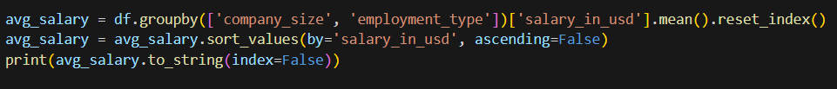



Which employment types are best paid within different company sizes

Slide 31


Results / Findings
📌 1. Salary vs. Experience Level
Senior-level professionals earn the highest average salaries.

Slide 32

📌 2. Top Paying Roles & Countries
The highest-paying roles include Data Analyst, Data Scientist, Product Manager.
USA, GB(United Kingdom of Great Britain and Northern Ireland), Mexico emerged as top-paying company locations.

Slide 33

📌 3. Remote Work Trends
Over 50% of jobs in the dataset were fully remote (remote_ratio = 100).
📌 4. Company Size & Salary
Medium size companies tend to offer higher average salaries than small or large sized firms.

Slide 34

📌 5. Regional Employment Trends
Countries with the highest number of tech employees: US(United States), CA(Canada), AU(Australia), GB(United Kingdom), NL(Netherlands).
📌 6. Salary Gaps Within Experience Levels
Senior and expert levels had large salary gaps, possibly due to variation in company budgets and global pay scales.

Slide 35


Slide 36

CONCLUSION
Experience Drives Earnings Salaries clearly increase with experience. Expert-level professionals earn significantly more than entry or mid-level employees, confirming a strong correlation between experience and compensation.
Large Companies Pay More Larger organizations generally offer higher average salaries, especially for full-time roles. However, some medium-sized firms offer competitive pay for specialized skills.
Remote Work is Here to Stay A high proportion of fully remote roles exists, with many offering competitive or even above-average salaries—highlighting the ongoing shift toward flexible, location-independent work environments.
Geographic Disparity in Pay Countries with the highest number of tech employees: US(United States), CA(Canada), AU(Australia), GB(United Kingdom), NL(Netherlands).
However, countries like India and Mexico show high employment numbers but lower salary averages, reflecting regional cost-of-living differences and outsourcing trends.
Demand for Data Roles Data-centric roles such as Data Analyst, Data Scientist, Product Manager consistently appear among the highest-paying positions, reaffirming the global demand for data-driven expertise.

Slide 37


--------AMAN GUPTA

